Slide 1
Name
17/8/2018
Chapter 5
Delegating Authority and Empowering Employees
Joyce Wheat’s Problem

Slide 2
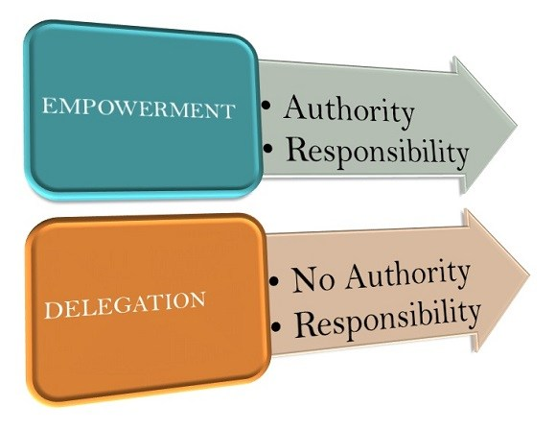
DELEGATION VS EMPOWERNMENT

Slide 3
STEPS TO DELEGATION- DIAGNOSIS
Make a decision on what to delegate
Decide on who has to do the task
Assigning of responsibilities
Granting of Authority
Establishing accountability

Slide 4
EFFECTIVE DELEGATION AND EMPOWERNMENT
Always beginnig with the end in ones mind
By allowing partication in the entire process
Working effectively towards parity between the responsibility and the authority.SS
Working within the structure of the organization

Slide 5
CRITICAL ISSUES OF CONCERN
Lack of proper understanding of the employee delegation and empowernment
Lack of effective communication between joyce and her staff members
High need for personal achievement
Failure in establishing of boundaries for employees
The believe in the principle of follow ups as her main principle

Slide 6
REASONS FOR PROBLEM EXISTANCE
Joyces believes that her staff requires constant supervision if they have to work in an effective manner.
Decisions being imposed from above without making proper of her consulations with other members of staffs.
By allowing of barriers to hinder the ability of other staffs in practising the empowered behaviour.

Slide 7
SOLUTION
Encouraging workers to make use of their own initiative by making their own informed decisions.
By changing management systems in order to be consistent with empowernment.
Removing of bureaucratic constraints as well as unnecessary controls.
Expressing of confidence and trust in people.

Slide 8
REFERENCE
Case 5-1 p. 156 Joyce Wheat’s Problem

